Slide 1
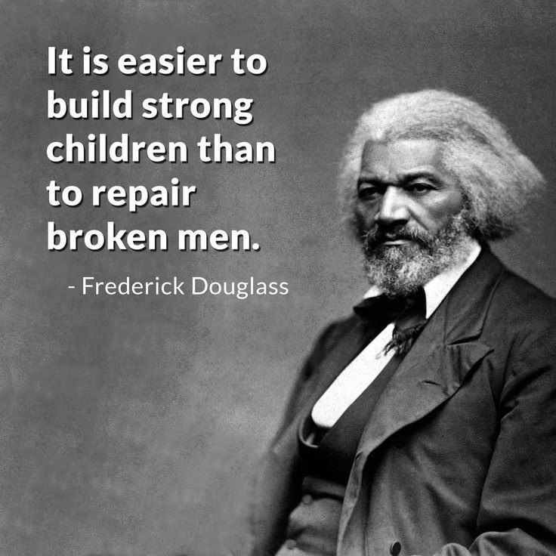
21st Century Learning Collaborative Work
Presented By: Sharell Edwards

Slide 2
What is collaborative learning?
A method that capitalizes on the learning advantages that come from learners working together to solve a problem or accomplish a task. (Reigeluth & Keller, 2009)
Working together!

Slide 3
Cooperation makes it happen…..

Slide 4
Concept
Students work together when the activity requires them to work in pairs or groups to:
discuss an issue
solve a problem
create a product

Slide 5
Build Deeper Understanding

Slide 6
Encouraging collaboration

Slide 7
Shared Responsibility
Work in pairs or groups to develop a common product, design, or response.
Students must collectively own the work and be mutually responsible for its outcome.
If the group work involves students or adults from outside the classroom, this qualifies as shared responsibility ONLY if the students and the outside participants are mutually responsible for the outcome of the work.

Slide 8
Make substantive decisions together
Resolve important issues that will guide their work
Decisions that shape the content, process, OR product of students’ work
Content: academic content of their work such as deciding on the hypothesis they will test.
Process: what tools they will use, or the roles and responsibilities of people on the team.
Product: Students must make fundamental design decisions that affect the nature and usability of their product.

Slide 9
Interdependent work
All students must participate in order for the team to succeed
Most interdependent work involves two levels of accountability:
Individual accountability: each individual on the team is responsible for a task that he or she must complete in order for the group to do its work. The role of each student on the team is essential.
Group accountability: the students must work together to produce the final product or outcome. Students must negotiate and agree on the process, design, and conclusions of their work.

Slide 10
Collaboration encourages
Negotiation
Conflict resolution
Agreement on what must be done
Distribution of tasks
Listening to the ideas of others
Integration of ideas into a coherent whole

Slide 11
Collaboration Rubric
In this learning activity:
1 Students are NOT required to work together in pairs or groups.
2 Students DO work together
BUT they DO NOT have shared responsibility.
3 Students DO have shared responsibility
BUT they ARE NOT required to make substantive decisions together.
4 Students DO have shared responsibility
AND they DO make substantive decisions together about the content, process, or product of their work
BUT their work is not interdependent.
5 Students DO have shared responsibility
AND they DO make substantive decisions together about the content, process, or product of their work
AND their work is interdependent.

Slide 12
Sir Robinson Ted talk Changing Education Paradigms

Slide 13
Professional Development

Slide 14
Let’s Collaborate!
http://sallysocialstudies.weebly.com/

