Slide 1
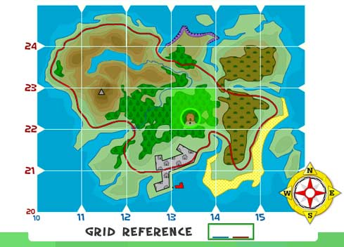
Grids
Grade 7

Slide 2
Objectives
Define grid reference
Explain why grids are important
Use a grid system to locate places on a map

Slide 3
What is a grid reference
A grid reference is a standard method for the location of a point on a map. The grid itself is a coordinate system imposed on a map.

Slide 4
What is a Grid System
1. Map grids are drawn on maps to help mapmakers find the exact location of a place.
2. A grid is a system of horizontal and vertical lines that cross each other to form squares.

Slide 5
What a grid system looks like

Slide 6
How is a grid system used
http://olc.spsd.sk.ca/DE/k9mod/Mapskill/grid1.swf
Remember the Location of something on a grid is given as Letter then Number for example A6 or the park is in A6

Slide 7
The Latitude & Longitude grid system
When latitude and longitude are combined on a map or globe they form a grid system.
What does it look like when latitude and longitude form a grid system.

Slide 8
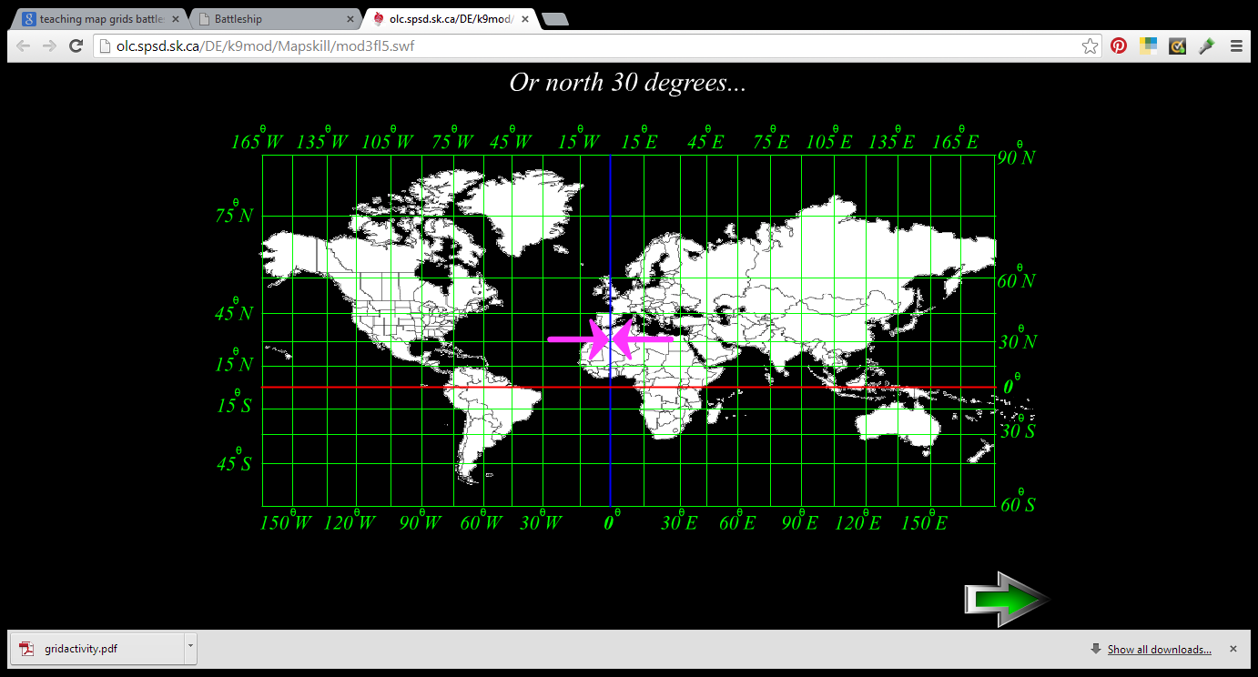
Latitude and Longitude Grid System

Slide 9
Lets apply our knowledge
Turn to the map of The Bahamas in the back of our classroom
1A.Where is the national fish of The Bahamas located?
1b. ( what is the name of this fish)
2a. Where is the national flower of The Bahamas located?
2b. (What is the name of this flower?)
3a. Where is the national bird of The Bahamas located?
3b. (What is the name of this bird?)
Next slide for conclusion

Slide 10
Conclusion
Turn to page 52 in your atlas for quick practice
What island and continent is located at H3?
What countries are located at C4?
What is the location of The Bahamas?

