Slide 1
MAPPING SKILLS BOARD GAME

Slide 2
PART A
PART B
PART C
100
100
100
200
200
200
300
300
300

Slide 3
True or False
The campus tells directions.
ANSWER

Slide 4
FALSE :P

Slide 5
What is the function of the legend?
ANSWER

Slide 6
To show you what the sign or symbol on a map represent.

Slide 7
WHAT IS ANOTHER NAME FOR THE LEGEND
ANSWER

Slide 8
A Key

Slide 9
What are the two main types of maps
ANSWER

Slide 10
POLITICAL & PHYSICAL

Slide 11
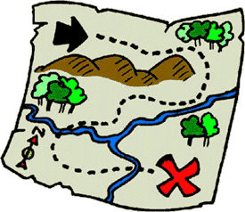
Identify the type of map shown.
ANSWER

Slide 12
Physical

Slide 13
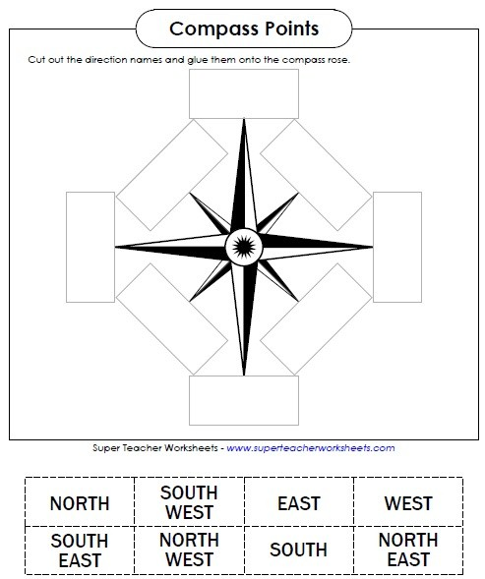
Label
ANSWER

Slide 14
NORTH
NORTH WEST
NORTH EAST
WEST
EAST
SOUTH EAST
SOUTH WEST
SOUTH

Slide 15
State one difference between longitude and latitude?
ANSWER

Slide 16
Longitude is shown as a vertical line, latitude lines are shown as a horizontal line. Longitude is the angular distance etc and seconds, of a point east or west of the Prime (Greenwich) Meridian.is the angular distance, in degrees, minutes, and seconds of a point north or south of the Equator

Slide 17
What is a map?
ANSWER

Slide 18
A map is a representation of physical features, cities, roads, etc.

Slide 19
Label the islands

Slide 20
ABACO
GRAND BAHAMA
ELEUTHERA
CAT ISLAND
ANDROS
NEW PROVIDENCE
SAN SALVADOR
EXUMA
CROOKEDISLAND
LONG ISLAND
MAYAGUANA
ACKLINS
INAGUA

